Slide 1
Database
Presented by: Ma Myint Myint
9.12.2010

Slide 2
JDBC Java Database Connectivity

Slide 3
Contents
Database Access Methods, ODBC, JDBC,JDBC Architecture
The java.sql package
DriverManager, Driver, Connection, Statement, ResultSet
Writing database applications

Slide 4
Why Database Access Methods need?
Databases help in easy retrieval and processing of data.
In order to update or query the database from applications, you will need to learn about SQL processing in DBMS.
This can be a tedious task for the application developer.
The solution is to build applications that will act as an interface between the application and the database.
The applications will accept values from the end user by using user-friendly GUIs, and update or query the database.

Slide 5
What is ODBC?
abbreviation for Open Database Connectivity.
an interface to access databases via SQL queries.
can be used as an access tool to various databases :
MS-Access, dBase, DB2, Excel, etc..
was first created by Microsoft and Simba Technologies.

Slide 6
How ODBC is Processed
To use the ODBC, three components are needed:
ODBC client,
ODBC driver, and
DBMS server (ex. Microsoft Access, SQL Server, Oracle, and FoxPro).
command
decoded command
ODBC
Client
ODBC
Driver
DBMS
Server
result
result

Slide 7
Overview of JDBC Technology
JDBC provides a standard library for accessing relational databases
API standardizes
way to establish connection to database
approach to initiating queries
method to create stored (parameterized) queries
the data structure of query result (table)
Determining the number of columns
Looking up metadata, etc.
API does not standardize SQL syntax
• JDBC is not embedded SQL
– JDBC classes are in the java.sql package

Slide 8
Functions of JDBC
Using JDBC, it is easy to send SQL statements to virtually any relational database.
JDBC makes it possible to do three things:
establish a connection with a database
send SQL statements
process the results

Slide 9
On-line Resources
Sun’s JDBC Site
– http://java.sun.com/products/jdbc/
JDBC Tutorial
– http://java.sun.com/docs/books/tutorial/jdbc/
List of Available JDBC Drivers
– http://industry.java.sun.com/products/jdbc/drivers/
API for java.sql
–http://java.sun.com/j2se/1.4/docs/api/java/sql/package-summary.html

Slide 10
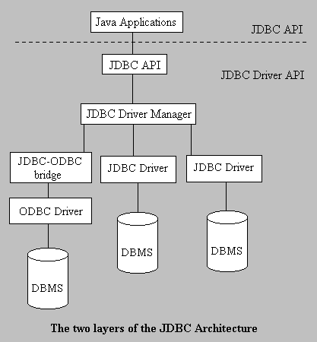
JDBC Architecture
consists of two layers:
the JDBC API, which provides the application-to-JDBC Manager connection, and
the JDBC Driver API, which supports the JDBC Manager-to-Driver Connection.

Slide 11
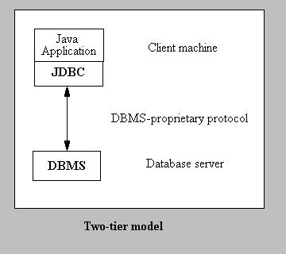
Two-Tier Model Supported by JDBC
Java applet or application talks directly to the database
referred to as a client/server configuration

Slide 12
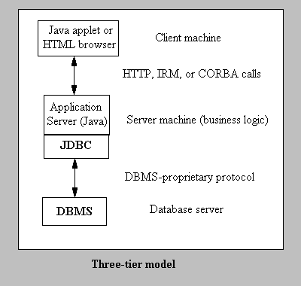
Three-Tier Model Supported by JDBC
possible to maintain control over access and the kinds of updates that can be made to corporate data
the middle-tier architecture can provide performance advantages

Slide 13
JDBC API
The Java environment provides you the JDBC API necessary to create Java applications that are capable of interacting with a database.
It is a simple class hierarchy for database objects.
Some classes contained in the java.sql package.
java.sql.DriverManager : loads driver, and creates the connection to the database
java.sql.Driver : represents a driver
java.sql.Connection : represents a connection to the database
Java.sql.Statement : executes statements
Java.sql.ResultSet : this holds results of executing statement

Slide 14
Connection Management
Java.sql.DriverManager | The basic service for managing a set of JDBC drivers.
Java.sql.Driver | The interface that every driver class must implement.
Java.sql.DriverPropertyInfo | Driver properties for making a connection.
Java.sql.Connection | A connection (session) with a specific database.

Slide 15
Database Access
Java.sql.Statement | The object used for executing a static SQL statement and returning the results it produces.
Java.sql.PreparedStatement | An object that represents a precompiled SQL statement.
Java.sql.CallableStatement | The interface used to execute SQL stored procedures.
Java.sql.ResultSet | A table of data representing a database result set, which is usually generated by executing a statement that queries the database.

Slide 16
Data Types
JDBC data types | Java Types
BIT | boolean
TINYINT | byte
SMALLINT | Short
INTEGER | int
BIGINT | long
REAL | float
FLOAT DOUBLE | double
BINARY VARBINARY LONGVARBINARY | byte[]
CHAR VARCHAR LONGVARCHAR | String
JDBC data types | Java Types
NUMERIC DECIMAL | BigDecimal
DATE | java.sql.Date
TIME TIMESTAMP | java.sql.Timestamp
CLOB | java.sql.Clob
BLOB | java.sql.Blob
ARRAY | java.sql.Array
DISTINCT | Mapping of underlying type
STRUCT | java.sql.Struct
REF | java.sql.Ref
JAVA_OBJECT | Underlying java classes

Slide 17
Database Metadata
Java.sql.DatabaseMetadata | Comprehensive information about the database as a whole.
Java.sql.ResultSetMetaData | An object that can be used to get information about the types and properties of the columns in a ResultSet object.
Java.sql.ParameterMetadata | An object that can be used to get information about the types and properties of the parameters in a PreparedStatement object.

Slide 18
Exceptions and Warnings
Java.sql.SQLException | An exception that provides information on a database access error or other errors.
Java.sql.SQLWarning | An exception that provides information on database access warnings.
Java.sql.BatchUpdateException | An exception thrown when an error occurs during a batch update operation.
Java.sql.DataTruncation | An exception that reports a DataTruncation warning (on reads) or throws a DataTruncation exception (on writes) when JDBC unexpectedly truncates a data value.

Slide 19
Seven Basic Steps in Using JDBC
1. Load the driver
2. Define the Connection URL
3. Establish the Connection
4. Create a Statement object
5. Execute a query
6. Process the results
7. Close the connection

Slide 20
JDBC: Details of Process
1. Load the driver
try {
Class.forName("connect.microsoft.MicrosoftDriver");
Class.forName("oracle.jdbc.driver.OracleDriver");
} catch (ClassNotFoundException cnfe) {
System.out.println("Error loading driver: " cnfe);
}
2. Define the Connection URL
URL = protocol + type of DB + host name + port + DB name;
e.g.,
String accessURL=“jdbc:odbc:dsn”;
String oracleURL = "jdbc:oracle:thin:@" + host +":" + port + ":" + dbName;
String sybaseURL = "jdbc:sybase:Tds:" + host +":" + port + ":" + "?SERVICENAME=" + dbName;

Slide 21
JDBC: Details of Process (Cont.)
3. Establish the Connection
String username = “*****";
String password = “***";
Connection connection =DriverManager.getConnection(URL,username,password);
• Optionally, look up information about the database
DatabaseMetaData dbMetaData =connection.getMetaData();
String productName =dbMetaData.getDatabaseProductName();
System.out.println("Database: " + productName);
String productVersion =dbMetaData.getDatabaseProductVersion();

Slide 22
JDBC: Details of Process (Cont.)
4. Create a Statement
Statement statement =connection.createStatement();
5. Execute a Query
String query = "SELECT col1, col2, col3 FROM sometable";
ResultSet resultSet = statement.executeQuery(query);
– To modify the database, use executeUpdate, supplying a string that uses UPDATE, INSERT, or DELETE – Use setQueryTimeout to specify a maximum delay to wait for results

Slide 23
JDBC: Details of Process (Cont.)
6. Process the Result
while(resultSet.next())
{
System.out.println(resultSet.getString(1) + “ ” + resultSet.getString(2) + “ ” + resultSet.getString(3));
} // First column has index 1, not 0
– ResultSet provides various getXxx methods that take a colu index or column name and returns the data
– You can also access result meta data (column names, etc.)
7. Close the Connection
connection.close();
– Since opening a connection is expensive, postpone this step if additional databaseoperations are expected

Slide 24
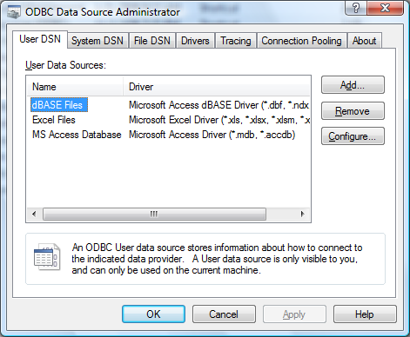
Example : Using Microsoft Access via ODBC
Create a Database (Database1) with a table named Student (Name, RollNo).
Click Start, Control Panel, Administrative Tools, Data Sources, and select Add

Slide 25
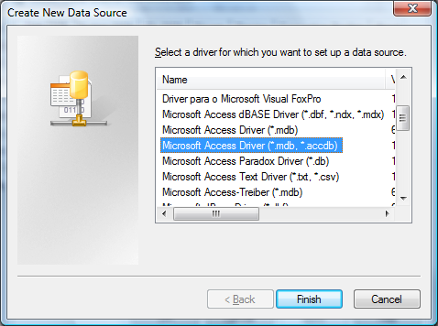
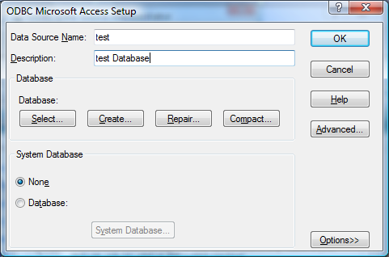
Example (Cont.)
Select Microsoft Access Driver, Finish, type a name under Data Source Name, and
hit Select

Slide 26
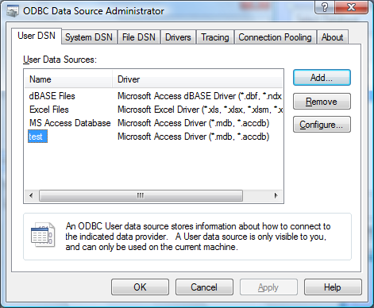
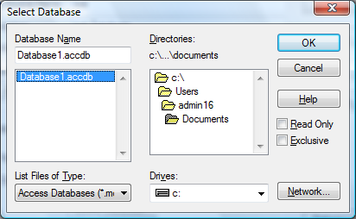
Example (Cont.)
Navigate to the directory of your database, select database, hit OK, then hit OK in
following two windows.

Slide 27
Example (Cont.)
Use sun.jdbc.odbc.JdbcOdbcDriver as the class name of the JDBC driver.
Class.forName("sun.jdbc.odbc.JdbcOdbcDriver");
• Use "jdbc:odbc:Northwind" as the database address, and use empty strings for the
username and password.
Connection con = DriverManager.getConnection("jdbc:odbc:test","","");

Slide 28
Example (Cont.)
import java.sql.*;
public class DBTest {
public static void main(String[] args) {
String driver ="sun.jdbc.odbc.JdbcOdbcDriver";
String url = "jdbc:odbc:test";
String username = "";
String password = "";
showEmployeeTable(driver, url,username, password);
}

Slide 29
Example (Cont.)
public static void showEmployeeTable(String driver, String url, String username, String password) {
try {
// Load database driver if not already loaded.
Class.forName(driver);
// Establish network connection to database.
Connection connection =
DriverManager.getConnection(url,username,password);
Statement statement =connection.createStatement();
String query ="SELECT * FROM Student";
// Send query to database and store results.
ResultSet rs=statement.executeQuery(query);

Slide 30
Example (Cont.)
// Print results.
while(resultSet.next()) {
System.out.print(resultSet.getString(1) + " "); // First column
System.out.println(resultSet.getInt(2)); // Second column
}
} catch(ClassNotFoundException cnfe) {
System.err.println("Error loading driver: " +cnfe);
} catch(SQLException sqle) {
System.err.println("Error connecting: " + sqle);
}
}//end function
}//end class

Slide 31
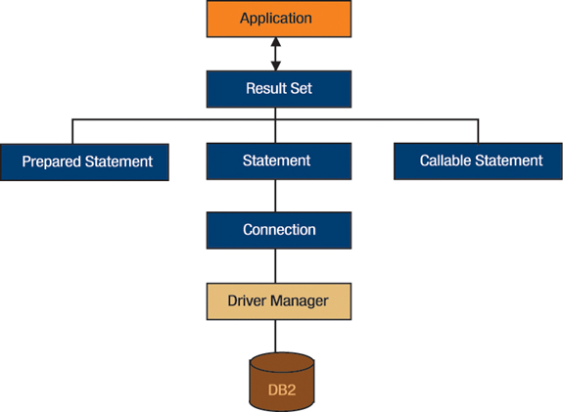
Three Types of Statement Classes

Slide 32
Using PreparedStatement
con = DriverManager.getConnection(url, "", "");
String sql="SELECT ID From Teachers where Name=?“;
PreparedStatement pstmt=con.prepareStatement(sql);
pstmt.setString(1,name);
ResultSet rs=pstmt.executeQuery();

Slide 33
Using MetaData
• System-wide data
connection.getMetaData().getDatabaseProductName()
connection.getMetaData().getDatabaseProductVersion()
• Table-specific data
resultSet.getMetaData().getColumnCount()
• When using the result, remember that the index starts at 1, not 0
– resultSet.getMetaData().getColumnName()

Slide 34
Example
import java.sql.*;
public class DBTest {
public static void main(String[] args) {
String driver = "sun.jdbc.odbc.JdbcOdbcDriver";
String url = "jdbc:odbc:test";
String username = "";
String password = "";
String tableName =“Student";
showInfo(driver, url, username, password,tableName);
}

Slide 35
Example (Cont.)
private void showInfo(String driver,String url,String username,String
password,String tableName) {
try {
Class.forName(driver);
Connection connection =DriverManager.getConnection(url, username,password);
DatabaseMetaData dbMetaData =connection.getMetaData();
String productName =dbMetaData.getDatabaseProductName();
System.out.println(“ Database: " + productName);
String productVersion =
dbMetaData.getDatabaseProductVersion();
System.out.println(“Version: " + productVersion);

Slide 36
Example (Cont.)
Statement statement = connection.createStatement();
String query = "SELECT * FROM " + tableName;
ResultSet resultSet = statement.executeQuery(query);
ResultSetMetaData resultsMetaData =resultSet.getMetaData();
int columnCount = resultsMetaData.getColumnCount();
for(int i=1; i<columnCount+1; i++) {
resultsMetaData.getColumnName(i));
}
while(resultSet.next()) {
for(int i=1; i<columnCount+1; i++) {
System.out.print(resultSet.getString(i));
} }

Slide 37
Transactions
The role of the transactions is to provide data integrity, correct application semantics, and a consistent view of data during concurrent access.
Transaction Managent in the JDBC API includes the following concepts:
Auto-commit mode
Transaction isolation level
Savepoint

Slide 38
Transaction
Idea
By default, after each SQL statement is executed the changes are automatically committed to the database
Turn auto-commit off to group two or more statements together into a transaction
connection.setAutoCommit(false)
Call commit to permanently record the changes to the database after executing a group of statements
Call rollback if an error occurs

Slide 39
Useful Connection Methods (for Transactions)
• getAutoCommit/setAutoCommit
– By default, a connection is set to auto-commit
– Retrieves or sets the auto-commit mode
• commit
– Force all changes since the last call to commit to become permanent
– Any database locks currently held by this Connection object are
released
• rollback
– Drops all changes since the previous call to commit
– Releases any database locks held by this Connection object

Slide 40
Transaction : Example
Connection connection=DriverManager.getConnection(url, username, passwd);
connection.setAutoCommit(false);
try {
statement.executeUpdate(...);
statement.executeUpdate(...);
connection.commit();
} catch (Exception e) {
try {
connection.rollback();
} catch (SQLException sqle) {// report problem}
} finally {
try {
connection.close();
} catch (SQLException sqle) { }
}

Slide 41
Lets make Exercise !

Slide 42
Thank you!!!

